Slide 1
Engineering Tech and Society
Team: “100% Funded” Group Project Proposal
Vancouver Community College - SCIE 1100
Instructor: Ali Habibzadeh, PhD, Peng, PMP
September 19, 2019
Malcolm, Scott, Jarome

Slide 2
What’s the problem?
Increased need for food worldwide
Overall rising costs of food globally
Need for reduced waste
Trouble growing food in suboptimal natural terrain
Customized personal dietary needs and requirements
Environmental impact and being self-sufficient is a growing focus due to both financial costs and the rising threat of climate change-based long-term impact

Slide 3
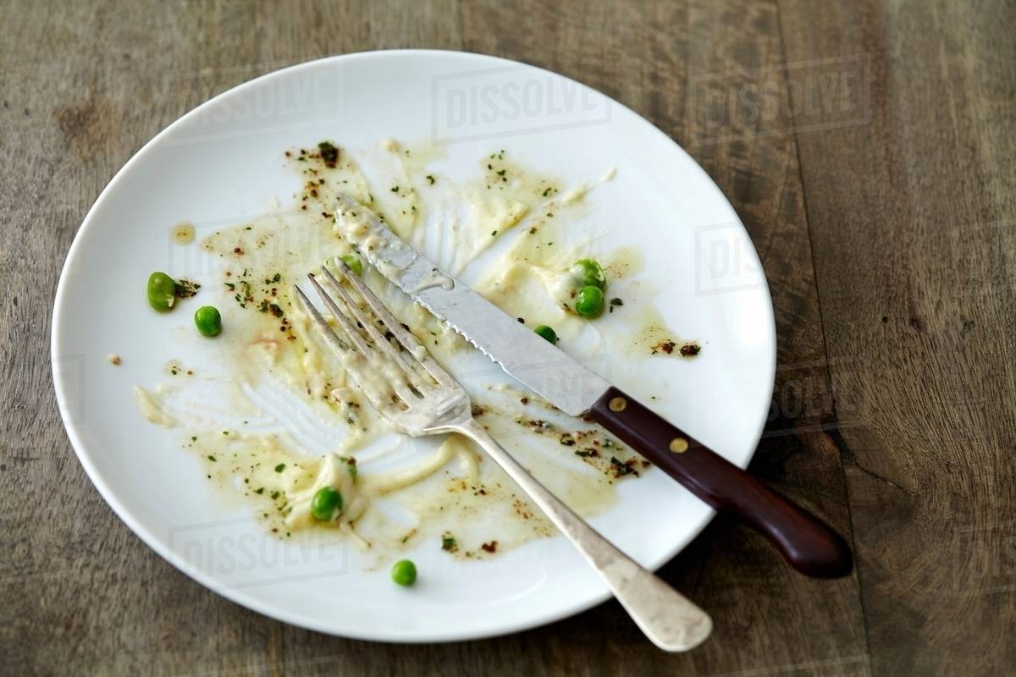

Slide 4
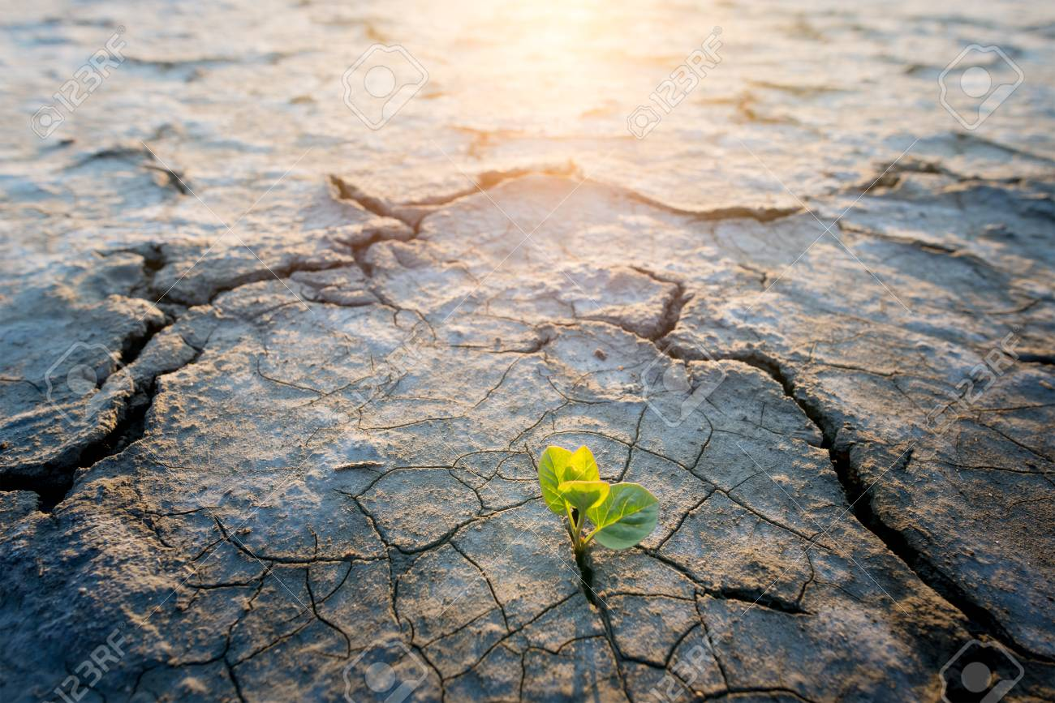

Slide 5
A number of potential solutions.
We looked at and brainstormed a number of currently available and ideal prototypes both online and from our personal experiences
Started as a jumble of general ideas that slowly formed into a cohesive whole
Initial ideas included everything from a cart that follows and locates sunlight via heat sensors to a modular system of interchangeable seed pods with built-in irrigation

Slide 6
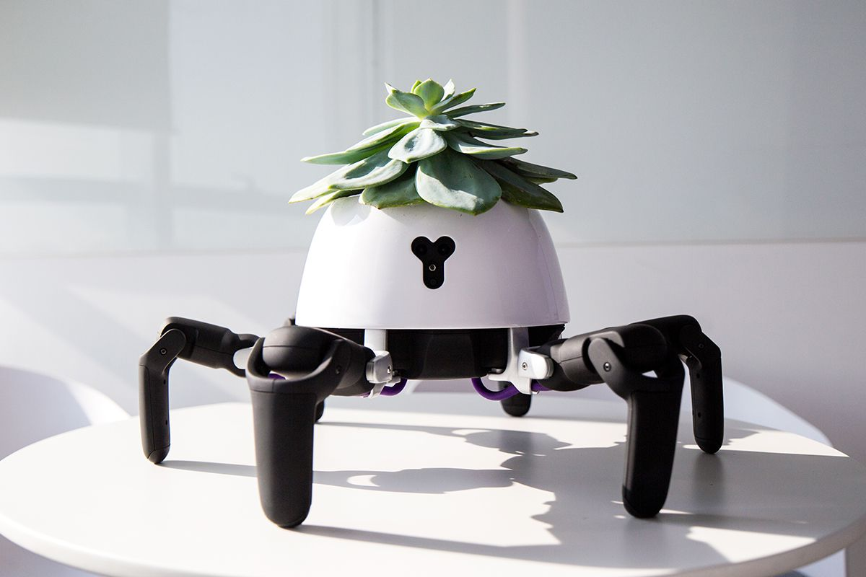

Slide 7
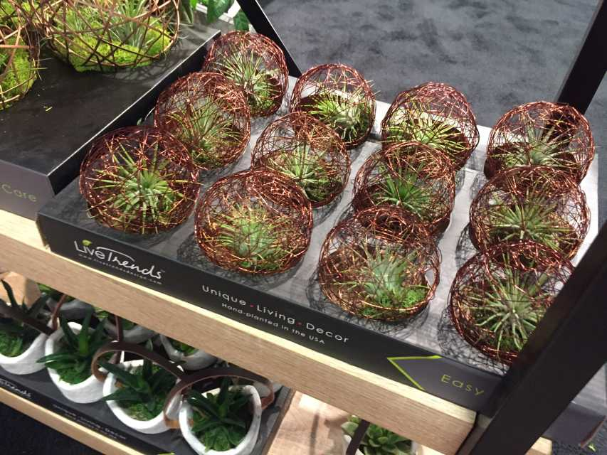

Slide 8
Our chosen solution!
Climate in a Box!
This is a simple, predominantly self-sustaining modular unit that can facilitate the growth of plants in most situations, particularly those where space and resources are more scarce and/or the skill level of the grower varies with experience.

Slide 9
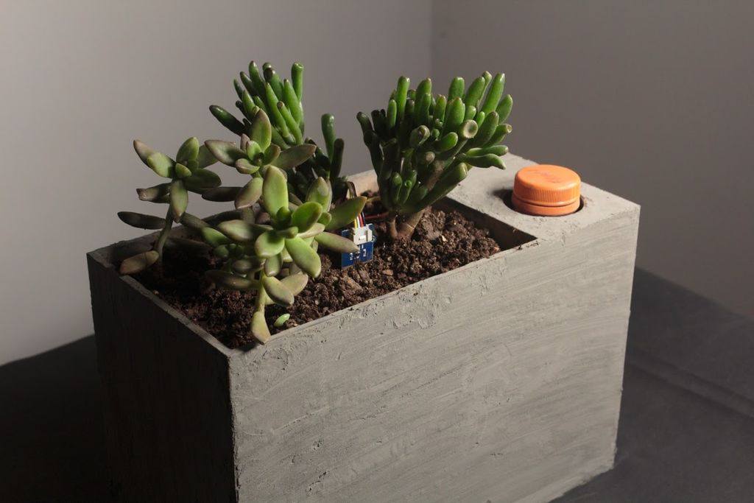

Slide 10
What skills do we need to do the thing?
Which skills do we already have?
Our group has varied, and relatively low, levels of experience with regards to building hardware of various types (woodworking, wiring electronics, coding, etc…). We, as a group, have the prerequisites required to begin the project and continue, but we will likely run into issues as we go due to our relative skill ceilings.
Which skills do we need to acquire?
As a group, we have limited experience with gardening, but it is a shared interest.
Working as a group and planning out a project of a technical nature
Building, etching, and soldering/wiring self-made PCB boards
Gardening and working with natural materials (water, soil, plant matter, etc…)
Presenting materials and projects in a technical environment.
Are we getting outside help from someone? (not in class)
Outside of the internet, we are receiving no additional assistance.

Slide 11
What gear will be needed to build our project?
Equipment:
Hand Tools (Saws, drills, soldering iron, etc…)
Computer (Coding, testing, etc…)
Acid (Etching)
Soil
Seeds
Planter with built in regulator.
Devices:
Water Pump
Instrumentation:
Soil sensors
Arduino Nano
Various regulators and modules

Slide 12
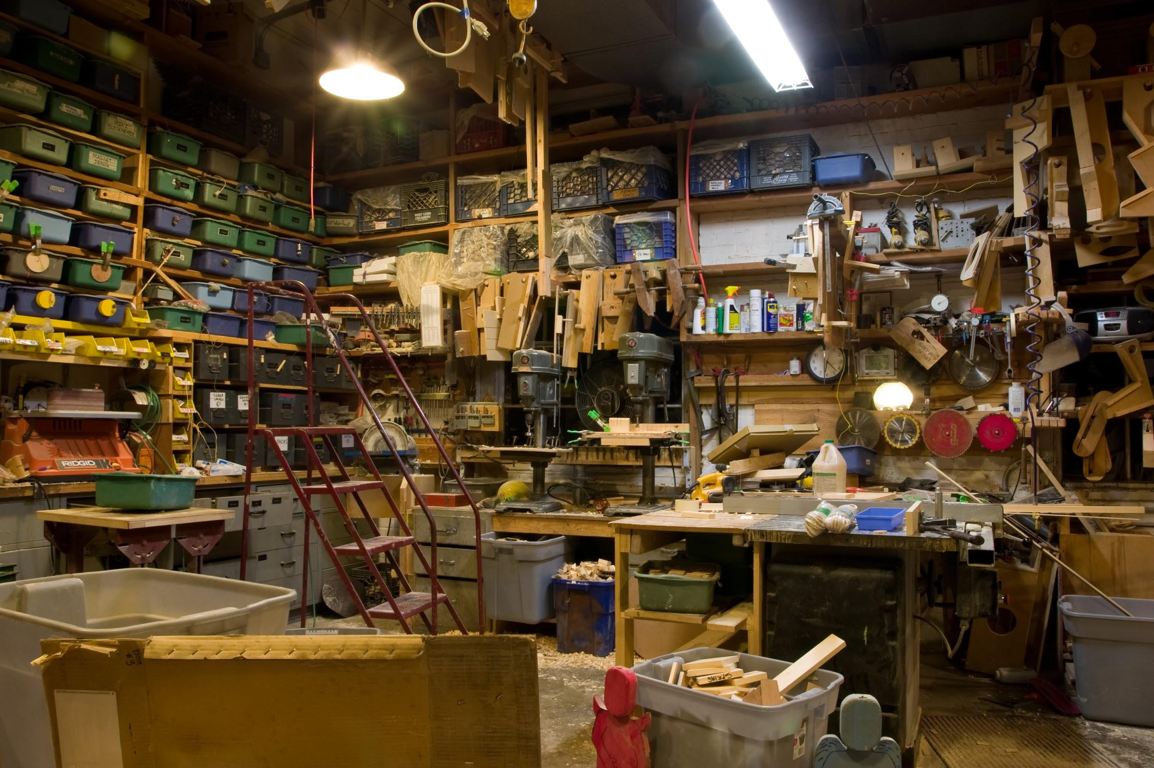

Slide 13
Project Timeline
Oct 1: Prototype Designs
Oct 15: Materials Obtained
Nov 1: Software outline created
Nov 15: Basic Construction of Box and rigging (min 50% complete)
Nov 30: Final assembly + Software implementation + Poster design complete
Dec 5: Testing completed + Poster complete

Slide 14
All about the money!
Electronics ≅ $30
Arduino Nano, DC Water Pump, Soil Moisture Sensor, HC-05 Bluetooth Module, LM7805 Voltage Regulator, IRF540 MOSFET, 220 Ohm Resistor, IN4001 Diode, Header Pin Strips, DC Barrel Jack, Screw Terminal Block, PCB, AC-12VDC Adapter
Seeds ≅ $10
Basil, Tomato, etc...
Hardware (wood, pots, etc…) ≅ $20
planter/box, soil, pipe, containers, etc...
Total ≅ $60
Budget ≅ $100-ish

Slide 15
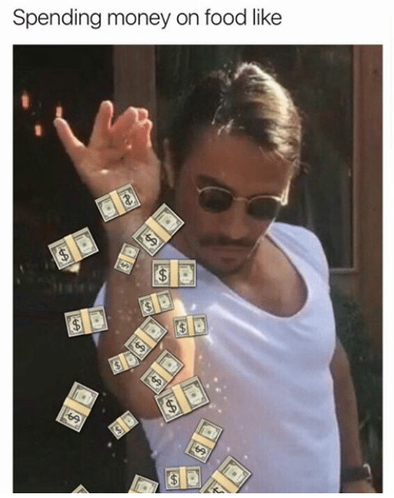

Slide 16
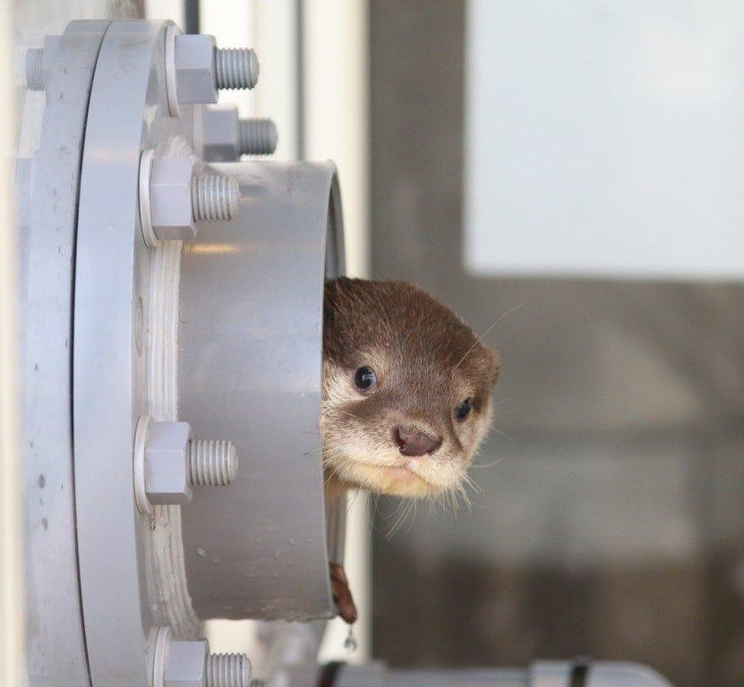
Thank you for coming to our TED Talk

